Slide 1
Object Oriented Programming C++ Operator Overloading
Abeeda Akram

Slide 2
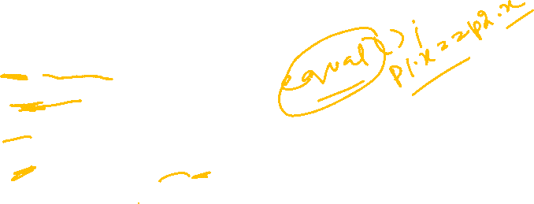
Operator Overloading
Perform operations on class objects (variables of user defined ADTs) as performed on system defined datatypes.
For Example:
cout << myobj;
myobj == otherobj;
myobj++;
myobj = otherobj + 3;

Slide 3

Operator Overloading Rules
You cannot
Change precedence of operators.
a=b+c*d; // order of execution *, +, =
a=b+c+d; // left hand rule b+c, +d, =
Change associativity of an operation.
a=b=c; //right to left
a+b-d; //left to right
Use default parameters in operator functions.
Change operands or parameters of an operation.
a+b; //binary operation take two operands
a++; //unary operation take one operand
5. Create new operators.

Slide 4
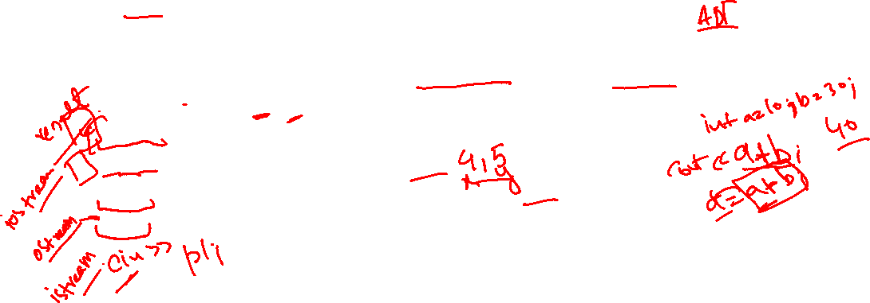
Operator Overloading Rules Con…
The meanings of operators with built in types should remain same.
Point p1, p2(2, 3);
p1+p2; //means addition not subtraction
Can overload either for class objects of user defined class or for combination of objects user defined and built in datatypes.
Point p1, p2(2, 3);
p1+p2; //both are class objects of Point class
p1+2; //class object and int
2+p1; //order matters for calling operator functions
cout << p1; //ostream and point class objects

Slide 5
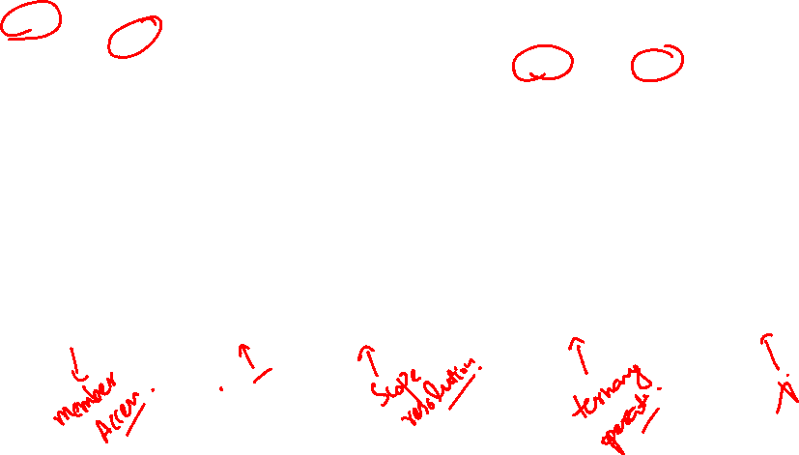
Operator Overloading Rules Con…
Operators that can be overloaded:
Operators that cannot be overloaded:
+ | - | * | / | % | ^ | & | |
~ | ! | = | < | > | += | -= | *=
/= | %= | ^= | &= | |= | << | >> | >>=
<<= | == | != | <= | >= | && | || | ++
-- | ->* | , | -> | [] | () | new | delete
new[] | delete[]
. | .* | :: | ?: | sizeof

Slide 6

Operators classification
Unary Operators:
- (minus), !, ++ (pre and post), -- (pre and post), ~ ( bitwise not) , & (address of)
Binary Operators:
Arithmetic -, +, *, /, % , +=, -=, *=, /=, %=
Relational ==, !=, >=,<=, <, >
Assignment =
Logical &&, ||
Subscript []
Member access ->
Stream operators can be overload for file stream or command line stream
<< (stream insertion), >> (stream extraction)
Bitwise: &, |, >> (shift right), <<(shift left), ^ (XOR)
Memory management: new, delete
Operators must be overloaded explicitly
Overloading + does not overload +=

Slide 7

Operator Function
Operator function can be defined as
Non-static member function of a class.
Non-member function.
Operator function header contains
return type
operator reserve word
operator symbol
parameters list
void operator ++ ();
//unary increment operator as member function
Point operator * (const Point & p);
// binary operator as member function

Slide 8
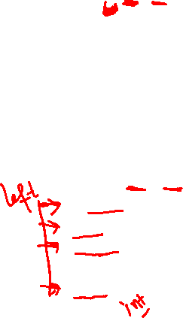
Member Functions
Can be defined inside class as member or just add prototype and define outside as normal member functions.
Operators that must be overloaded through member functions are:
=, [], (), ->, &(address of operator)
Unary operators: its good practice to define member function for unary operators.
Member function, needs no argument.
Binary operators:
Member function, needs one argument right operand can be class object or other datatype.
Left operand must be class object
All operators can be overloaded through member functions in which left operand is class object for example:
Point p1, p2(2, 3);
p1 + p2; //both are class objects of Point class
p1++;
p1 = p2;
//left operand is class object member function will work
p1 + 3;

Slide 9
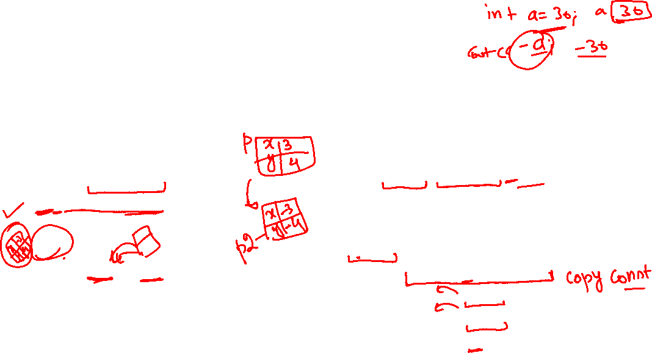
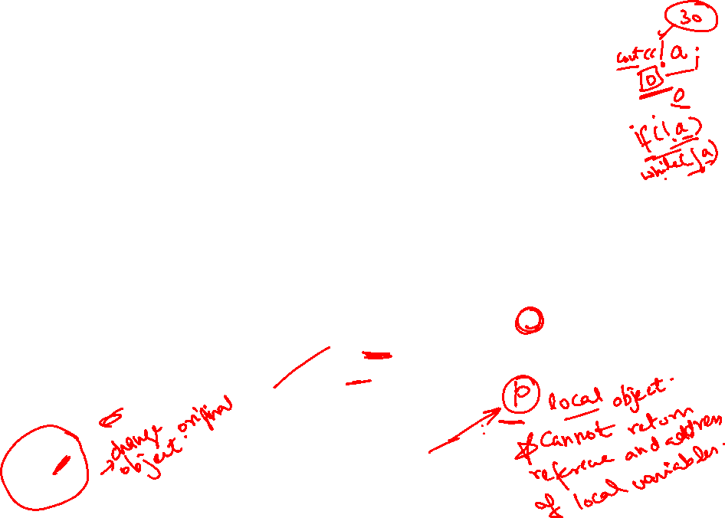
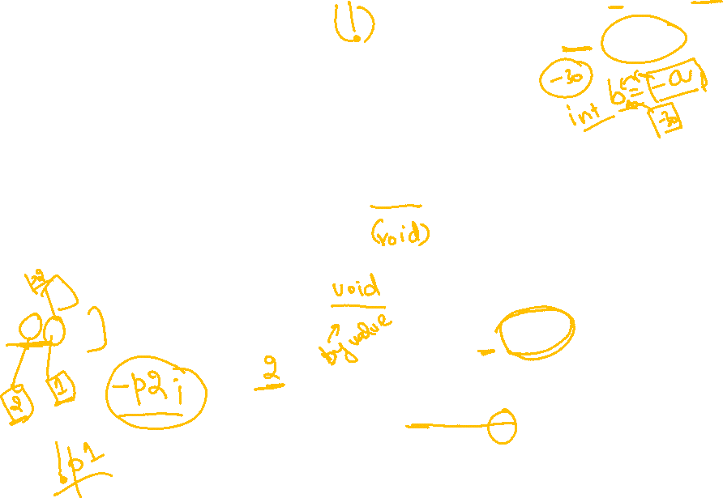
Unary Operator Minus (-)
Member function takes no argument work on single operand must be the class object.
Can be called in two ways.
Point p1(3, 4);
p1.operator-();
Or
-p1;
Point p2 = -p1;
// cascaded call
class Point {
int x, y;
public:
Point(int a=0, int b=0) { x=a; y=b;}
Point operator–(); // prototype
};
//implementation
Point Point:: operator-() {
Point p(*this);
p.x = -p.x;
p.y = -p.y;
return p;
}

Slide 10
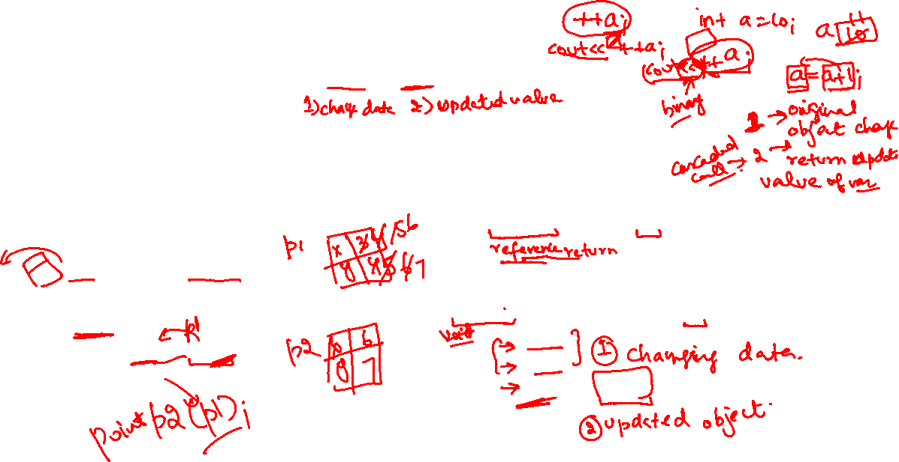
Unary Operators (++) pre increment
Member function takes no argument work on single operand must be the class object.
Can be called in two ways.
Point p1(3, 4);
p1.operator++();
Or
++p1;
Point p2 = ++p1;
// cascaded call
class Point {
int x, y;
public:
Point(int a=0, int b=0) { x=a; y=b; }
Point& operator++(); // prototype
};
//implementation
Point& Point:: operator++() {
x++;
y++;
return *this;
}

Slide 11
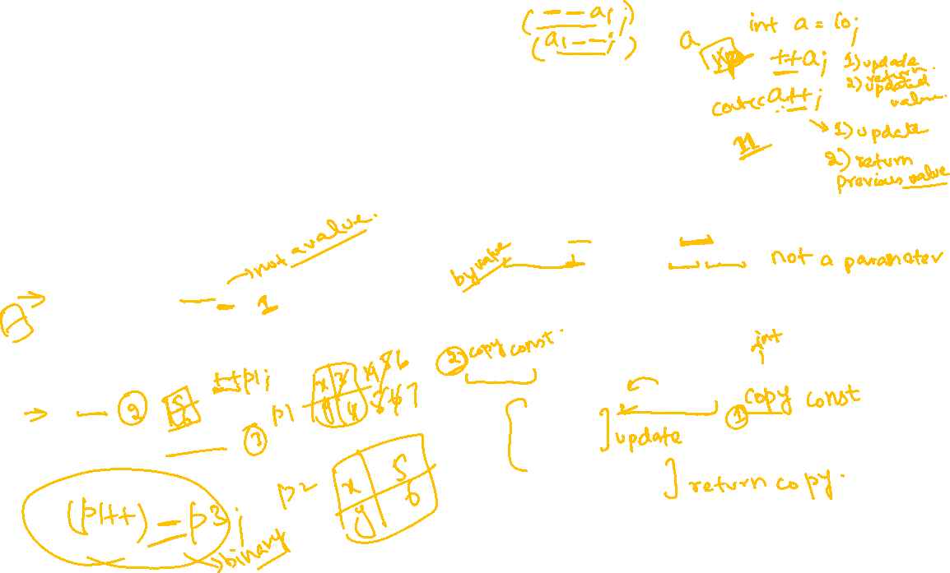
Unary Operators post increment (++)
Member function takes no argument work on single operand must be the class object.
Can be called in two ways.
Point p1(3, 4);
p1.operator++(0);
// dummy zero to tell system post increment
Or
p1++;
Point p2 = p1++;
// cascaded call
class Point {
int x, y;
public:
Point(int a=0, int b=0) { x=a; y=b;}
Point& operator++(); // pre
Point operator++(int);
//post with dummy int lable
};
//implementation
Point Point:: operator++() {
Point p(*this);
x++;
y++;
return p;
}

